Slide 1
Analytic Geometry and Conic Sections
Precalculus
Chapter 7

Slide 2
This Slideshow was developed to accompany the textbook
Precalculus
By Richard Wright
https://www.andrews.edu/~rwright/Precalculus-RLW/Text/TOC.html
Some examples and diagrams are taken from the textbook.
Slides created by
Richard Wright, Andrews Academy
rwright@andrews.edu

Slide 3
7-01 Lines
In this section, you will:
Find the inclination of a line.
Calculate the angle between two lines.
Find the distance between a point and a line.

Slide 4
7-01 Lines
Conic sections
Intersections of a plane with a double cone

Slide 5
7-01 Lines
Parabola
Ellipse
Hyperbola

Slide 6
7-01 Lines
Point
Single Line
Intersecting Lines
Degenerate
Degenerate
Degenerate
Notes:
The point and lines are called degenerate conic sections because they do not produce curves.

Slide 7
7-01 Lines
Lines
$Ax+By+C=0$ or $y=mx+b$
Inclination
Describes steepness of line
Angle it makes with positive x-axis
$\tan{θ}=\frac{y}{x}=slope$
$\tan{θ}=m$
Where $0°<θ<180°$
If $θ<0$, add 180°
Notes:
m = slope

Slide 8
7-01 Lines
Find the inclination of 4x − 2y + 5 = 0.
Notes:
First, find the slope by rewriting the equation in slope-intercept form.
$$y=2x+\frac{5}{2}$$
The slope is 2.
Find the inclination.
$$\tan{θ}=2$$
$$θ=\tan^{−1}{2}$$
$$θ≈63.4°$$

Slide 9
7-01 Lines
Angle between Two Lines
$β+θ_{2}=180°$ (linear pair)
$β=180°−θ_{2}$
$θ_{1}+α+β=180°$ (triangle sum)
$α=180°−θ_{1}−β$
$α=180°−θ_{1}−\left(180°−θ_{2}\right)$
$α=θ_{2}−θ_{1}$
$θ=α$ (vertical angles)
$θ=θ_{2}−θ_{1}$

Slide 10
7-01 Lines
Written as slopes
$\tan{θ}=\tan\left(θ_{2}−θ_{1}\right)$
$\tan{θ}=\frac{\tan{θ_{2}}−\tan{θ_{1}}}{1+\tan{θ_{2}}\tan{θ_{1}}}$
Because the tangents are slopes
$\tan{θ}=\left|\frac{m_{2}−m_{1}}{1+m_{1}m_{2}}\right|$
Where $0°<θ<90°$

Slide 11
7-01 Lines
Find the angle between $2x+y=4$ and $x−y=2$.
Notes:
Find the slopes
$$2x+y=4$$
$y=−2x+4$ m = -2
$$x−y=2$$
$y=x−2$ m = 1
$$\tan{θ}=\left|\frac{m_{2}−m_{1}}{1+m_{1} m_{2}}\right|$$
$$\tan{θ}=\left|\frac{1−\left(−2\right)}{1+\left(1\right)\left(−2\right)}\right|$$
$$\tan{θ}=\left|\frac{3}{−1}\right|$$
$$\tan{θ}=3$$
$$θ=\tan^{−1}{3}$$
$$θ≈71.6°$$

Slide 12
7-01 Lines
Distance from a Point to a Line
This is derived in your book and online.
Point $\left(x_{1}, y_{1}\right)$ and Line $Ax+By+C=0$
$d=\frac{\left|Ax_{1}+By_{1}+C\right|}{\sqrt{A^{2}+B^{2}}}$

Slide 13
7-01 Lines
Find the distance from (0, 2) to $4x+3y=0$.
Notes:
The point is $\left(x_{1}, y_{1}\right)$ so
$$x_{1}=0$$
$$y_{1}=2$$
The line is $Ax+By+C=0$
$$A=4, B=3, C=0$$
$$d=\frac{\left|Ax_{1}+By_{1}+C\right|}{\sqrt{A^{2}+B^{2}}}$$
$$d=\frac{\left|4\left(0\right)+3\left(2\right)+0\right|}{\sqrt{4^{2}+3^{2}}}$$
$$d=\frac{6}{5}$$

Slide 14
7-02 Parabolas
In this section, you will:
Find the focus, vertex, and directrix of a parabola.
Write the standard equation of a parabola.
Graph a parabola.

Slide 15
7-02 Parabolas
Parabolas
set of all points in a plane that are equidistant from a fixed line, called the directrix and a fixed point, called the focus.
Vertex
max or min point
midpoint between the focus and directrix.
Axis of symmetry
line perpendicular to the directrix
goes through the focus and vertex.
Parabola bends around the focus and away from the directrix.

Slide 16
7-02 Parabolas
Vertical Parabola
Horizontal Parabola
p = directed (+, -) distance from vertex to focus
Vertex $\left(h,k\right)$
Focus $\left(h, p+k\right)$
Directrix $y=k−p$
$${\left(x−h\right)}^{2}=4p\left(y−k\right)$$
p = directed (+, -) distance from vertex to focus
Vertex $\left(h,k\right)$
Focus $\left(p+h, k\right)$
Directrix $x=h−p$
$${\left(y−k\right)}^{2}=4p\left(x−h\right)$$

Slide 17
7-02 Parabolas
Find the vertex, focus, and directrix of the parabola given by $y=\frac{1}{2}x^{2}$.
Notes:
Rearrange the equation to standard form
$$x^{2}=2y$$
Since it is $x^{2}$, it is a vertical parabola
$${\left(x−h\right)}^{2}=4p\left(y−k\right)$$
$$h=0, k=0$$
$4p=2$ so $p=\frac{1}{2}$
Vertex (h, k)
$$\left(0, 0\right)$$
Focus $\left(h, p+k\right)$
$$\left(0,\frac{1}{2}+0\right)=\left(0,\frac{1}{2}\right)$$
Directrix
$$y=−\frac{1}{2}$$

Slide 18
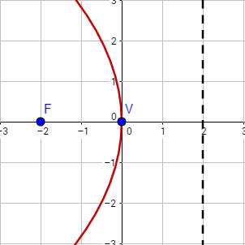
7-02 Parabolas
Find the standard form of the equations of a parabola with vertex at (0, 0) and focus (-2, 0).
Notes:
The line through the points is horizontal
Vertex (h, k) = (0, 0)
Dist from vertex to focus = 2 left
p = -2
$${\left(y−k\right)}^{2}=4p\left(x−h\right)$$
$${\left(y−0\right)}^{2}=4\left(−2\right)\left(x−0\right)$$
$$y^{2}=−8x$$

Slide 19
7-02 Parabolas
Find the vertex, focus, and directrix of the parabola given by $x^{2}−2x−16y−31=0$.
Notes:
$x^{2}$ so vertical parabola
Arrange the terms to fit standard form
$$x^{2}−2x=16y+31$$
Complete the square (add ${\left(\frac{1}{2}b\right)}^{2}$ )
$$x^{2}−2x+{\left(\frac{1}{2}\left(−2\right)\right)}^{2}=16y+31+{\left(\frac{1}{2}\left(−2\right)\right)}^{2}$$
$$x^{2}−2x+1=16y+32$$
Factor
$${\left(x−1\right)}^{2}=16\left(y+2\right)$$
Compare to ${\left(x−h\right)}^{2}=4p\left(y−k\right)$
$$h=1, k=−2$$
$4p=16$, so $p=4$
Vertex $\left(h, k\right)$
$$\left(1, −2\right)$$
Focus $\left(h,p+k\right)$
$$\left(1, 2\right)$$
Directrix $y=k−p$
$$y=−2−4=−6$$

Slide 20
7-02 Parabolas
Graph ${\left(x−1\right)}^{2}=16\left(y+2\right)$
Notes:
Solve for y and make a table of values
$$y=\frac{{\left(x−1\right)}^{2}}{16}−2$$

Slide 21
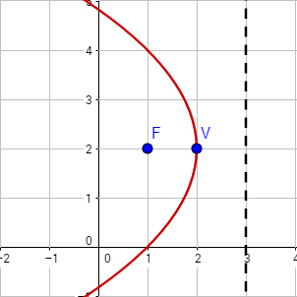
7-02 Parabolas
Write the standard form of the equation of the parabola with focus (1, 2) and directrix $x=3$.
Notes:
Directrix is vertical, so axis is horizontal
Graph the focus and directrix
Vertex is midway between (2, 2)
$$h=2,k=2$$
Distance from vertex to focus is 1 left
$$p=−1$$
$${\left(y−k\right)}^{2}=4p\left(x−h\right)$$
$${\left(y−2\right)}^{2}=4\left(−1\right)\left(x−2\right)$$
$${\left(y−2\right)}^{2}=−4\left(x−2\right)$$

Slide 22
7-03 Ellipses and Circles
In this section, you will:
Find the foci, vertices, and covertices of an ellipse.
Write the standard equation of an ellipse.
Graph an ellipse.

Slide 23
7-03 Ellipses and Circles
Ellipse
Set of all points in a plane where the sum of the distances to two fixed points, foci, is constant.
Major axis
Longest segment across the ellipse
Connects the two vertices.
Minor axis
Shortest segment across the ellipse
Connects the two covertices.
Circle
Special form of an ellipse where both foci are at the center.

Slide 24
7-03 Ellipses and Circles
Horizontal Ellipse
Vertical Ellipse
a = distance from center to vertex
b = distance from center to covertex
c = distance from center to focus
Center $\left(h, k\right)$
Horizontal Major Axis length = 2a
Vertical Minor Axis length = 2b
$$c^{2}=a^{2}−b^{2}$$
Vertices $\left(h±a, k\right)$
Covertices $\left(h, k±b\right)$
Foci $\left(h±c, k\right)$
$$\frac{{\left(x−h\right)}^{2}}{a^{2}}+\frac{{\left(y−k\right)}^{2}}{b^{2}}=1$$
Center $\left(h, k\right)$
Vertical Major Axis length = 2a
Horizontal Minor Axis length = 2b
$$c^{2}=a^{2}−b^{2}$$
Vertices $\left(h, k±a\right)$
Covertices $\left(h±b,k\right)$
Foci $\left(h, k±c\right)$
$$\frac{{\left(y−k\right)}^{2}}{a^{2}}+\frac{{\left(x−h\right)}^{2}}{b^{2}}=1$$

Slide 25
7-03 Ellipses and Circles
Find the center, vertices, and foci of the ellipse $9x^{2}+4y^{2}=36$.
Notes:
Put in standard form ($÷36$) to get 1
$$\frac{x^{2}}{4}+\frac{y^{2}}{9}=1$$
Bigger denominator is $a^{2}$
$$\frac{y^{2}}{9}+\frac{x^{2}}{4}=1$$
y is over big denominator so vertical
$$\frac{{\left(y−k\right)}^{2}}{a^{2}}+\frac{{\left(b−h\right)}^{2}}{b^{2}}=1$$
$a^{2}=9$ so $a=3$
$b^{2}=4$ so $b=2$
$$c^{2}=a^{2}−b^{2}$$
$$c^{2}=9−4$$
$$c=\sqrt{5}$$
$$h=0, k=0$$
Center $\left(h, k\right)$
(0, 0)
Vertices $\left(h, k±a\right)$
$$\left(0, ±3\right)$$
Covertices $\left(h±b, k\right)$
$$\left(±2, 0\right)$$
Foci $\left(h, k±c\right)$
$$\left(0, ±\sqrt{5}\right)$$

Slide 26
7-03 Ellipses and Circles
Find the standard form of the ellipse centered at (1, 2) with major axis length 10 and foci (-2, 2) and (4, 2).
Notes:
Graph the center and foci
Major axis is horizontal
Center (h, k) = (1, 2)
Major axis length 10 = 2a, so a = 5
c is distance from center to foci, c = 3
$c^{2}=a^{2}−b^{2}$, so b = 4
$$\frac{{\left(x−1\right)}^{2}}{25}+\frac{{\left(y−2\right)}^{2}}{16}=1$$

Slide 27
7-03 Ellipses and Circles
Graph $\frac{{\left(x−1\right)}^{2}}{25}+\frac{{\left(y−2\right)}^{2}}{16}=1$
Notes:
$a^{2}=25$, so $a=5$
$b^{2}=16$, so $b=4$
Vertices $\left(h±a, k\right)$
$\left(−4, 2\right)$ and $\left(6, 2\right)$
Covertices $\left(h, k±b\right)$
$(1, −2)$ and $\left(1, 6\right)$
Graph by plotting the vertices and covertices and drawing your best ellipse

Slide 28
7-03 Ellipses and Circles
Sketch the graph of $25x^{2}+9y^{2}−200x+36y+211=0$
Continues on next slide
Notes:
Complete the square by moving the constant to the other side and factor x’s and y’s
$$25\left(x^{2}−8x\right)+9\left(y^{2}+4y\right)=−211$$
Add ${\left(\frac{1}{2}b\right)}^{2}$ for both x and y
$$25\left(x^{2}−8x+{\left(\frac{1}{2}\left(−8\right)\right)}^{2}\right)+9\left(y^{2}+4y+{\left(\frac{1}{2}\left(4\right)\right)}^{2}\right)=−211+25{\left(\frac{1}{2}\left(−8\right)\right)}^{2}+9{\left(\frac{1}{2}\left(4\right)\right)}^{2}$$
$$25\left(x^{2}−8x+16\right)+9\left(y^{2}+4y+4\right)=−211+400+36$$
Factor
$$25{\left(x−4\right)}^{2}+9{\left(y+2\right)}^{2}=225$$

Slide 29
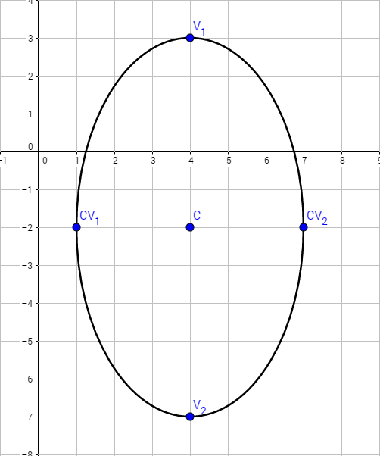
7-03 Ellipses and Circles
Notes:
$$h=4, k=−2$$
$a^{2}=25$, so $a=5$
$b^{2}=9$, so $b=3$
Graph by plotting center (4, -2).
Vertices are up and down a = 5
$\left(4, 3\right)$ and $\left(4, −7\right)$
Covertices are left/right b = 3
$\left(1, −2\right)$ and $\left(7, −2\right)$

Slide 30
7-03 Ellipses and Circles
Eccentricity
Measure of how circular an ellipse is
$e=\frac{c}{a}$ where $0<e<1$
If $e≈0$, then ellipse is almost a circle
If $e≈1$, then ellipse is almost a line

Slide 31
7-04 Hyperbolas
In this section, you will:
Find the foci, vertices, covertices, and asymptotes of a hyperbola.
Write the standard equation of a hyperbola.
Graph a hyperbola.
Classify conics based on the general equation.

Slide 32
7-04 Hyperbolas
Hyperbolas
Set of all points in a plane where the difference of the distances from two set points, foci, is constant.
d₁ – d₂ = constant.

Slide 33
7-04 Hyperbolas
Horizontal Hyperbola
Vertical Hyperbola
Eccentricity
$e=\frac{c}{a}$
Where $e>1$
Big e = linear branches
Center $\left(h, k\right)$
Horizontal Transverse Axis length = 2a
Vertical Conjugate Axis length = 2b
$$c^{2}=a^{2}+b^{2}$$
Vertices $\left(h±a, k\right)$, Covertices $\left(h, k±b\right)$
Foci $\left(h±c, k\right)$
$$\frac{{\left(x−h\right)}^{2}}{a^{2}}−\frac{{\left(y−k\right)}^{2}}{b^{2}}=1$$
Asymptotes $y=k±\frac{b}{a}\left(x−h\right)$
Center $\left(h, k\right)$
Vertical Transvers Axis length = 2a
Horizontal Conjugate Axis length = 2b
$$c^{2}=a^{2}+b^{2}$$
Vertices $\left(h, k±a\right)$, Covertices $\left(h±b,k\right)$
Foci $\left(h, k±c\right)$
$$\frac{{\left(y−k\right)}^{2}}{a^{2}}−\frac{{\left(x−h\right)}^{2}}{b^{2}}=1$$
Asymptotes $y=k±\frac{a}{b}\left(x−h\right)$

Slide 34
7-04 Hyperbolas
Find the center, vertices, asymptotes, and foci of the hyperbola $4y^{2}−9x^{2}=36$.
Notes:
Write in standard form by dividing by 36.
$$\frac{y^{2}}{9}−\frac{x^{2}}{4}=1$$
Because y comes first, vertical hyperbola
$$\frac{{\left(y−k\right)}^{2}}{a^{2}}−\frac{{\left(x−h\right)}^{2}}{b^{2}}=1$$
$$h=0, k=0, a=3, b=2$$
$$c^{2}=a^{2}+b^{2}$$
$$c=\sqrt{13}$$
Center $\left(h,k\right)$
$$\left(0, 0\right)$$
Vertices $\left(h, k±a\right)$
$(0, −3)$ and $\left(0, 3\right)$
Asymptotes $y=k±\frac{a}{b}\left(x−h\right)$
$$y=±\frac{3}{2}x$$
Foci $\left(h, k±c\right)$
$\left(0, −\sqrt{13}\right)$ and $\left(0, \sqrt{13}\right)$

Slide 35
7-04 Hyperbolas
Find the standard form of the hyperbola centered at (1, 2) with transverse axis length 10 and foci (-5, 2) and (7, 2).
Notes:
Graph the center and foci
Transverse axis is horizontal
Center (h, k) = (1, 2)
Transverse axis length 10 = 2a, so a = 5
c is distance from center to foci, c = 6
$c^{2}=a^{2}+b^{2}$, so $b=\sqrt{11}$
$$\frac{{\left(x−1\right)}^{2}}{25}−\frac{{\left(y−2\right)}^{2}}{11}=1$$

Slide 36
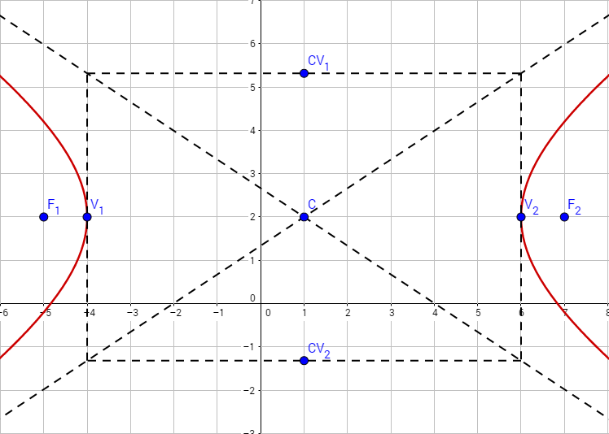
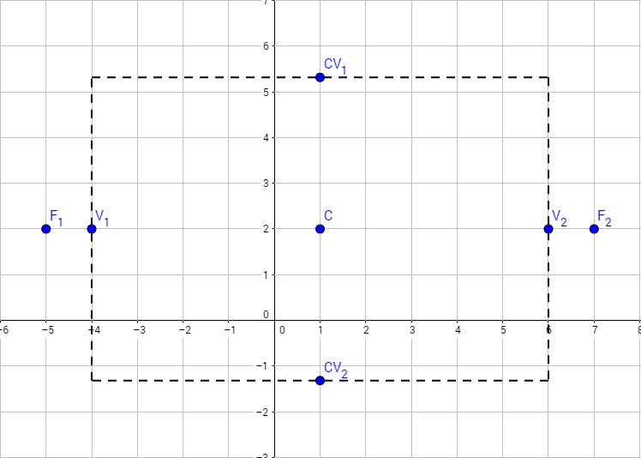
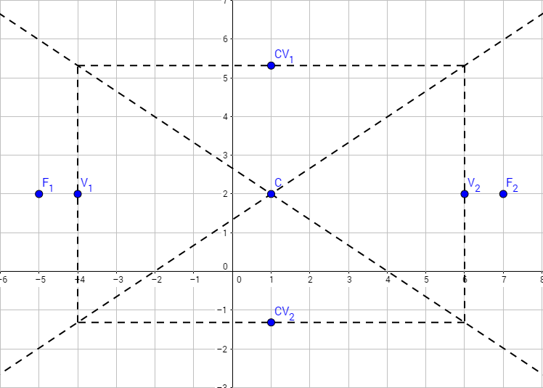
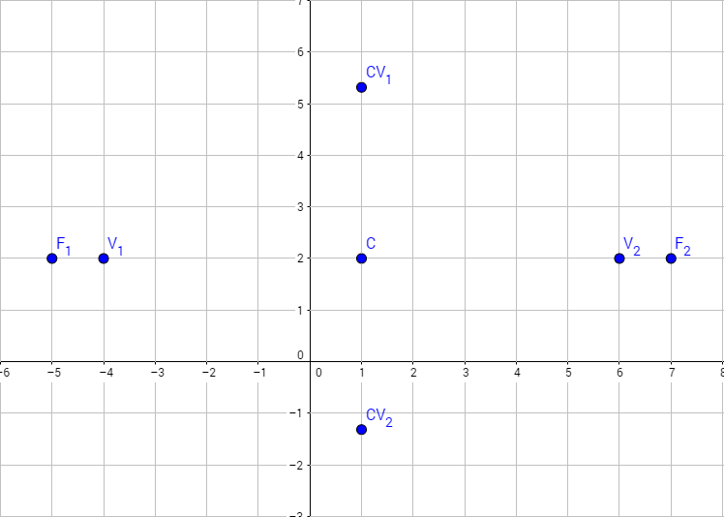
7-04 Hyperbolas
Graph $\frac{{\left(x−1\right)}^{2}}{25}−\frac{{\left(y−2\right)}^{2}}{11}=1$
Notes:
$a^{2}=25$, so $a=5$
$b^{2}=11$, so $b=\sqrt{11}$
Vertices $\left(h±a, k\right)$
$\left(−4, 2\right)$ and $\left(6, 2\right)$
Covertices $\left(h, k±b\right)$
$(1, −1.32)$ and $\left(1, 5.32\right)$
Graph by plotting the vertices and covertices
Drawing a rectangle
Draw diagonal lines through corners of rectangle
Sketch the hyperbola starting near asymptote, curve through vertex, end near other asymptote

Slide 37
7-04 Hyperbolas
Sketch the graph of $4x^{2}−9y^{2}−24x−72y−72=0$
Continues on next slide
Notes:
Complete the square by moving the constant to the other side and factor x’s and y’s
$$4\left(x^{2}−6x\right)−9\left(y^{2}+8y\right)=72$$
Add ${\left(\frac{1}{2}b\right)}^{2}$ for both x and y
$$4\left(x^{2}−6x+{\left(\frac{1}{2}\left(−6\right)\right)}^{2}\right)−9\left(y^{2}+8y+{\left(\frac{1}{2}\left(8\right)\right)}^{2}\right)=72+4{\left(\frac{1}{2}\left(−6\right)\right)}^{2}−9{\left(\frac{1}{2}\left(8\right)\right)}^{2}$$
$$4\left(x^{2}−6x+9\right)−9\left(y^{2}+8y+16\right)=72+36−144$$
Factor
$$4{\left(x−3\right)}^{2}−9{\left(y+4\right)}^{2}=−36$$

Slide 38
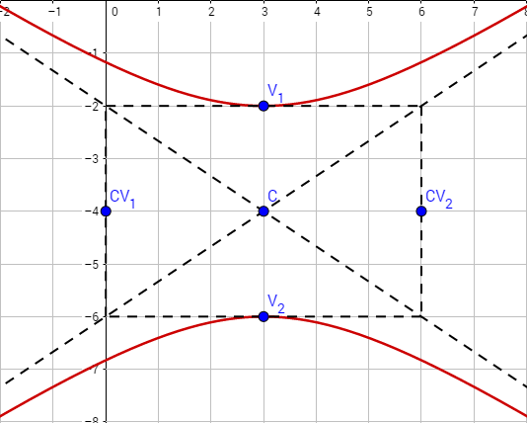
7-04 Hyperbolas
Notes:
$$h=3, k=−4$$
$a^{2}=4$, so $a=2$
$b^{2}=9$, so $b=3$
Graph by plotting center (3, -4).
Vertices are up and down a = 2
$\left(3, −2\right)$ and $\left(3, −6\right)$
Covertices are left/right b = 3
$\left(0, −4\right)$ and $\left(6, −4\right)$

Slide 39
7-04 Hyperbolas
General form of conics
$Ax^{2}+Cy^{2}+Dx+Ey+F=0$
Circle if $A=C$
Parabola if $AC=0$ (so $A=0$ or $C=0$)
Ellipse if $AC>0$
Hyperbola if $AC<0$
Classify the conics
$4x^{2}+5y^{2}−9x+8y=0$
$2x^{2}−5x+7y−8=0$
$7x^{2}+7y^{2}−9x+8y−16=0$
$4x^{2}−5y^{2}−x+8y+1=0$
Notes:
$AC=4\left(5\right)=20$ Ellipse
$AC=2\left(0\right)=0$ Parabola
$A=C=7$ Circle
$AC=4\left(−5\right)=−20$ Hyperbola

Slide 40
7-05 Rotated Conics
In this section, you will:
Write rotated conics equations in standard form.
Graph rotated conics.
Classify conics by their equation.

Slide 41
7-05 Rotated Conics
Nonrotated conics form Ax² + Cy² + Dx + Ey + F = 0.
Either horizontal or vertical.
Rotated conics form Ax² + Bxy + Cy² + Dx + Ey + F = 0.
Not horizontal or vertical
Bxy term prevents completing the square to write the conics in standard form.
To graph or write them in standard form, the Bxy term needs to be eliminated.
Then write the equation in the form A′(x′)² + C′(y′)² + D′x′ + E′y′ + F′ = 0 by rotating the coordinate axes counterclockwise through the angle θ, where
$\cot{2θ}=\frac{A−C}{B}$
Where $0<2θ<180°$ and $0<θ<90°$

Slide 42
7-05 Rotated Conics
Classify Rotated Conics
If the conic is in the form Ax² + Bxy + Cy² + Dx + Ey + F = 0, then
If B² – 4AC < 0 → ellipse or circle
If B² – 4AC = 0 → parabola
If B² – 4AC > 0 → hyperbola

Slide 43
7-05 Rotated Conics
Write Rotated Conics in Standard Form
Given a conic written as Ax² + Bxy + Cy² + Dx + Ey + F = 0
Find the angle of rotation using $\cot{2θ}=\frac{A−C}{B}$ where $0<θ<\frac{π}{2}$
Find sin θ and cos θ.
If θ is a special angle, evaluate sin θ and cos θ directly.
If θ is not a special angle,
Find cot 2θ.
Reciprocal to find tan 2θ.
Use 1 + tan² u = sec² u to find sec 2θ. (If tan 2θ < 0, then sec 2θ < 0.)
Reciprocal to find cos 2θ.
Use the half-angle formulas to find sin θ and cos θ. $\sin{θ}=\sqrt{\frac{1−\cos{2θ}}{2}}$ and $\cos{θ}=\sqrt{\frac{1+\cos{2θ}}{2}}$

Slide 44
7-05 Rotated Conics
Find the substitutions for x and y using $x=x^{′}\cos{θ}−y^{′}\sin{θ}$ $y=x^{′}\sin{θ}+y^{′}\cos{θ}$
Make the substitutions and arrange the terms into standard form.
Graph a Rotated Conic
Draw the rotated axes.
Using the rotated axes, sketch the conic.

Slide 45
7-05 Rotated Conics
Write $xy=\frac{1}{2}$ in standard form
Notes:
Classify the conic
$$B^{2}−4AC$$
$$1^{2}−4\left(0\right)\left(0\right)=1>0$$
Hyperbola
Find the angle of rotation
$$\cot{2θ}=\frac{A−C}{B}=\frac{0}{1}=0$$
$$2θ=\frac{π}{2}$$
$$θ=\frac{π}{4}$$
Find the substitutions for x and y.
$$x=x^{′}\cos{\frac{π}{4}}−y^{′}\sin{\frac{π}{4}}$$
$$y=x^{′}\sin{\frac{π}{4}}+y^{′}\cos{\frac{π}{4}}$$
$$x=\frac{\sqrt{2}}{2}x′−\frac{\sqrt{2}}{2}y′$$
$$y=\frac{\sqrt{2}}{2}x′+\frac{\sqrt{2}}{2}y′$$

Slide 46
7-05 Rotated Conics
Notes:
Substitute these into the original equation and simplify.
$$xy=\frac{1}{2}$$
$$\left(\frac{\sqrt{2}}{2}x^{′}−\frac{\sqrt{2}}{2}y^{′}\right)\left(\frac{\sqrt{2}}{2}x^{′}+\frac{\sqrt{2}}{2}y^{′}\right)=\frac{1}{2}$$
$$\frac{1}{2}{\left(x^{′}\right)}^{2}−\frac{1}{2}\left(x^{′}y^{′}\right)+\frac{1}{2}\left(x^{′}y^{′}\right)−\frac{1}{2}{\left(y^{′}\right)}^{2}=\frac{1}{2}$$
$${\left(x^{′}\right)}^{2}−{\left(y^{′}\right)}^{2}=1$$

Slide 47
7-05 Rotated Conics
Sketch the graph of $x^{2}+\sqrt{3}xy+2y^{2}−2=0$.
Notes:
Classify the conic
$$B^{2}−4AC$$
$${\left(\sqrt{3}\right)}^{2}−4\left(1\right)\left(2\right)=−5<0$$
Ellipse
Find the angle of the rotation.
$$\cot{2θ}=\frac{A−C}{B}=\frac{1−2}{\sqrt{3}}=−\frac{1}{\sqrt{3}}$$
$$2θ=\frac{2π}{3}$$
$θ=\frac{π}{3}$
Find the substitutions for x and y.
$$x=x^{′}\cos{\frac{π}{3}}−y^{′}\sin{\frac{π}{3}}$$
$$y=x^{′}\sin{\frac{π}{3}}+y^{′}\cos{\frac{π}{3}}$$
$$x=\frac{1}{2}x^{′}−\frac{\sqrt{3}}{2}y^{′}$$
$$y=\frac{\sqrt{3}}{2}x′+\frac{1}{2}y′$$

Slide 48
7-05 Rotated Conics
Notes:
Substitute these into the original equation and simplify.
$${\left(\frac{1}{2}x^{′}−\frac{\sqrt{3}}{2}y^{′}\right)}^{2}+\sqrt{3}\left(\frac{1}{2}x^{′}−\frac{\sqrt{3}}{2}y^{′}\right)\left(\frac{\sqrt{3}}{2}x^{′}+\frac{1}{2}y^{′}\right)+2{\left(\frac{\sqrt{3}}{2}x^{′}+\frac{1}{2}y^{′}\right)}^{2}−2=0$$
$$\frac{1}{4}{\left(x^{′}\right)}^{2}−\frac{\sqrt{3}}{2}x^{′}y^{′}+\frac{3}{4}{\left(y^{′}\right)}^{2}+\sqrt{3}\left(\frac{\sqrt{3}}{4}{\left(x^{′}\right)}^{2}+\frac{1}{4}x^{′}y^{′}−\frac{3}{4}x^{′}y^{′}−\frac{\sqrt{3}}{4}{\left(y^{′}\right)}^{2}\right)+2\left(\frac{3}{4}{\left(x^{′}\right)}^{2}+\frac{\sqrt{3}}{2}x^{′}y^{′}+\frac{1}{4}{\left(y^{′}\right)}^{2}\right)−2=0$$
$$\frac{1}{4}{\left(x^{′}\right)}^{2}−\frac{\sqrt{3}}{2}x^{′}y^{′}+\frac{3}{4}{\left(y^{′}\right)}^{2}+\frac{3}{4}{\left(x^{′}\right)}^{2}+\frac{\sqrt{3}}{4}x^{′}y^{′}−\frac{3\sqrt{3}}{4}x^{′}y^{′}−\frac{3}{4}{\left(y^{′}\right)}^{2}+\frac{3}{2}{\left(x^{′}\right)}^{2}+\sqrt{3}x^{′}y^{′}+\frac{1}{2}{\left(y^{′}\right)}^{2}−2=0$$
$$\frac{5}{2}{\left(x^{′}\right)}^{2}+\frac{1}{2}{\left(y^{′}\right)}^{2}=2$$
Divide by to write to make the equation equal 1.
$$\frac{{\left(x^{′}\right)}^{2}}{4/5}+\frac{{\left(y^{′}\right)}^{2}}{4}= 1$$

Slide 49
7-05 Rotated Conics
Notes:
$$\frac{{\left(x^{′}\right)}^{2}}{4/5}+\frac{{\left(y^{′}\right)}^{2}}{4}= 1$$
Vertical ellipse with $a=2$ and $b=\frac{2\sqrt{5}}{5}$ and center (0, 0).
Draw the rotated axis, then move $a=2$ along the rotated y-axis and $b=\frac{2\sqrt{5}}{5}$ along the rotated x-axis.
Connect the points with a nice ellipse.

Slide 50
7-05 Rotated Conics
Sketch the graph of $3x^{2}+2\sqrt{3}xy+y^{2}+2x−2\sqrt{3}y=0$.
Notes:
Classify the conic
$$B^{2}−4AC$$
$${\left(2\sqrt{3}\right)}^{2}−4\left(3\right)\left(1\right)=0$$
Parabola
Find the angle of rotation.
$$cot 2θ=\frac{A−C}{B}=\frac{3−1}{2\sqrt{3}}=\frac{\sqrt{3}}{3}$$
$$2θ=\frac{π}{3}$$
$θ =\frac{π}{6}$
Find the substitutions for x and y.
$$x=x^{′}cos\frac{π}{6}−y^{′}sin\frac{π}{6}$$
$$y=x^{′}sin\frac{π}{6}+y^{′}cos\frac{π}{6}$$
$$x=\frac{\sqrt{3}}{2}x^{′}−\frac{1}{2}y^{′}$$
$$y=\frac{1}{2}x′+\frac{\sqrt{3}}{2}y′$$

Slide 51
7-05 Rotated Conics
Substitute these into the original equation and simplify.
Notes:
$$3{\left(\frac{\sqrt{3}}{2}x^{′}−\frac{1}{2}y^{′}\right)}^{2}+2\sqrt{3}\left(\left(\frac{\sqrt{3}}{2}x^{′}−\frac{1}{2}y^{′}\right)\left(\frac{1}{2}x^{′}+\frac{\sqrt{3}}{2}y^{′}\right)\right)+{\left(\frac{1}{2}x^{′}+\frac{\sqrt{3}}{2}y^{′}\right)}^{2}+2\left(\frac{\sqrt{3}}{2}x^{′}−\frac{1}{2}y^{′}\right)−2\sqrt{3}\left(\frac{1}{2}x^{′}+\frac{\sqrt{3}}{2}y^{′}\right)=0$$
$$3\left(\frac{3}{4}{\left(x^{′}\right)}^{2}−\frac{\sqrt{3}}{2}x^{′}y^{′}+\frac{1}{4}{\left(y^{′}\right)}^{2}\right)+2\sqrt{3}\left(\frac{\sqrt{3}}{4}{\left(x^{′}\right)}^{2}+\frac{3}{4}x^{′}y^{′}−\frac{1}{4}x^{′}y^{′}−\frac{\sqrt{3}}{4}{\left(y^{′}\right)}^{2}\right)+\left(\frac{1}{4}{\left(x^{′}\right)}^{2}+\frac{\sqrt{3}}{2}x^{′}y^{′}+\frac{3}{4}{\left(y^{′}\right)}^{2}\right)+\left(\sqrt{3}x^{′}−y^{′}\right)−\left(\sqrt{3}x^{′}−3y^{′}\right)=0$$
$$\frac{9}{4}{\left(x^{′}\right)}^{2}−\frac{3\sqrt{3}}{2}x^{′}y^{′}+\frac{3}{4}{\left(y^{′}\right)}^{2}+\frac{3}{2}{\left(x^{′}\right)}^{2}+\frac{3\sqrt{3}}{2}x^{′}y^{′}−\frac{\sqrt{3}}{2}x^{′}y^{′}−\frac{3}{2}{\left(y^{′}\right)}^{2}+\frac{1}{4}{\left(x^{′}\right)}^{2}+\frac{\sqrt{3}}{2}x^{′}y^{′}+\frac{3}{4}{\left(y^{′}\right)}^{2}+\sqrt{3}x^{′}−y′−\sqrt{3}x′−3y′=0$$
$$4{\left(x^{′}\right)}^{2}−4y′=0$$
$$y′={\left(x^{′}\right)}^{2}$$

Slide 52
7-05 Rotated Conics
Notes:
$y′={\left(x^{′}\right)}^{2}$
This is a vertical parabola. Graph it by drawing the rotated axes and plotting points.

Slide 53
7-05 Rotated Conics
Classify the graph, use the quadratic formula to solve for y, and use a graphing utility to graph the equation. $3x^{2}−6xy+3y^{2}+2y=0$
Notes:
Classify the graph using the discriminant.
$B^{2}−4AC=\left(−6\right)2−4\left(3\right)\left(3\right)=0$, so it is a parabola.
To solve for y, rearrange terms in powers of y and factor.
$$3y^{2}+\left(2y−6xy\right)+3x^{2}=0$$
$$3y^{2}+\left(2−6x\right)y+3x^{2}=0$$
Now fill in the quadratic formula: $y=\frac{−b±\sqrt{b^{2}−4ac}}{2a}$
$$y=\frac{−\left(2−6x\right)±\sqrt{{\left(2−6x\right)}^{2}−4\left(3\right)\left(3x^{2}\right)}}{2\left(3\right)}$$
Because of the ± sign, you will have to input two equations, one with + and one with -, to make the graph.

Slide 54
7-06 Parametric Equations
In this section, you will:
Graph parametric equations.
Write parametric equations.
Eliminate the parameter.

Slide 55
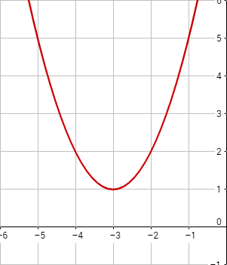
7-06 Parametric Equations
Parametric Equations
Separate equations for x and y
x and y are functions of a third variable called a parameter
Graph $\left\{\begin{aligned}x=t−3 \\ y=t^{2}+1\end{aligned}\right.$
Make a table
t | x | y
-2 | -5 | 5
-1 | -4 | 2
0 | -3 | 1
1 | -2 | 2
2 | -1 | 5
3 | 0 | 10

Slide 56
7-06 Parametric Equations
Graph $\left\{\begin{aligned}x=2\cos{θ} \\ y=2\sin{θ}\end{aligned}\right.$ for $0≤θ≤2π$
t | x | y
$$0$$ | $$2$$ | $$0$$
$$π/4$$ | $$\sqrt{2}$$ | $$\sqrt{2}$$
$$π/2$$ | $$0$$ | $$2$$
$$3π/4$$ | $$−\sqrt{2}$$ | $$\sqrt{2}$$
$$π$$ | $$−2$$ | $$0$$
$$5π/4$$ | $$−\sqrt{2}$$ | $$−\sqrt{2}$$
$$3π/2$$ | $$0$$ | $$−2$$
$$7π/4$$ | $$\sqrt{2}$$ | $$−\sqrt{2}$$

Slide 57
7-06 Parametric Equations
Eliminating the Parameter
Solve one equation for parameter
Substitute it into the other equation
Eliminate the parameter of $\left\{\begin{aligned}x=\frac{1}{\sqrt{t}} \\ y=2t^{2}\end{aligned}\right.$
Notes:
Solve one eq for t
$$x=\frac{1}{\sqrt{t}}$$
$$x\sqrt{t}=1$$
$$t=\frac{1}{x^{2}}$$
Substitute into the other
$$y=2\left(t^{2}\right)$$
$$y=2{\left(\frac{1}{x^{2}}\right)}^{2}$$
$$y=\frac{2}{x^{4}}$$

Slide 58
7-06 Parametric Equations
Eliminate the parameter in $\left\{\begin{aligned}x=2\cos{θ} \\ y=2\sin{θ}\end{aligned}\right.$
Notes:
Direct substitution is difficult so use identities
Remember $\sin^{2}{θ}+\cos^{2}{θ}=1$
Square both equations
$$x^{2}=4\cos^{2}{θ}$$
$$y^{2}=4\sin^{2}{θ}$$
Add the new equations
$$x^{2}+y^{2}=4\cos^{2}{θ}+4\sin^{2}{θ}$$
$$x^{2}+y^{2}=4\left(\cos^{2}{θ}+\sin^{2}{θ}\right)$$
$$x^{2}+y^{2}=4$$

Slide 59
7-06 Parametric Equations
Finding parametric equations
Choose something convenient to equal t
Find parametric equations for $y=4x−3$
Notes:
Simple choice ($x=t$)
$$\left\{\begin{aligned}x=t \\ y=4t−3\end{aligned}\right.$$
Or more interesting ($t=4x$)
$$\left\{\begin{aligned}x=\frac{t}{4} \\ y=t−3\end{aligned}\right.$$

Slide 60
7-06 Parametric Equations
Find parametric equations for conics.
Parabola
Horizontal: $\left\{\begin{aligned}x&=pt^{2}+h \\ y&=2pt+k\end{aligned}\right.$
Vertical: $\left\{\begin{aligned}x&=2pt+h \\ y=pt^{2}+k\end{aligned}\right.$
Ellipse
Horizontal: $\left\{\begin{aligned}x&=h+a\cos{t} \\ y&=k+b\sin{t}\end{aligned}\right.$
Vertical: $\left\{\begin{aligned}x=h+b\sin{t} \\ y&=k+a\cos{t}\end{aligned}\right.$
Hyperbola
Horizontal: $\left\{\begin{aligned}x&=h+a\sec{t} \\ y&=k+b\tan{t}\end{aligned}\right.$
Vertical: $\left\{\begin{aligned}x=h+b\tan{t} \\ y&=k+a\sec{t}\end{aligned}\right.$

Slide 61
7-07 Polar Coordinates
In this section, you will:
Graph polar coordinates
Represent the same point multiple ways
Convert between polar and rectangular coordinates

Slide 62
7-07 Polar Coordinates
Why use rectangular coordinates to graph circles?
Use circles to graph circles
Polar coordinates
$\left(r,θ\right)$
r = distance from pole
$θ$ = angle counterclockwise from polar axis

Slide 63
7-07 Polar Coordinates
Graph
$A\left(4,\frac{π}{4}\right)$
$B\left(−5,\frac{2π}{3}\right)$
Negative r means go opposite
$C\left(3,−\frac{π}{6}\right)$
$=\left(3,\frac{11π}{6}\right)$

Slide 64
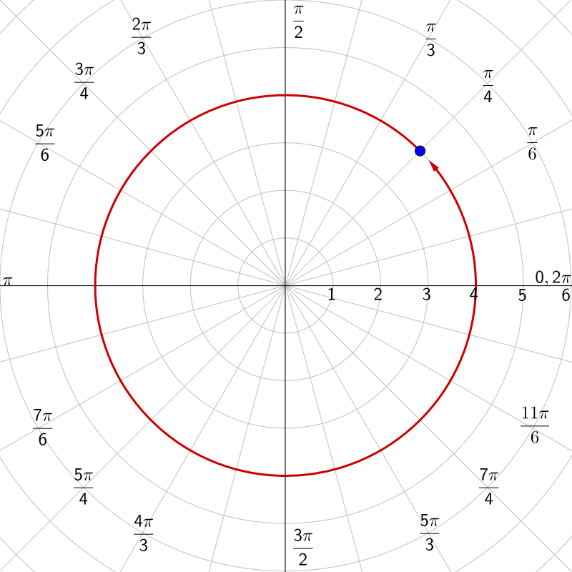
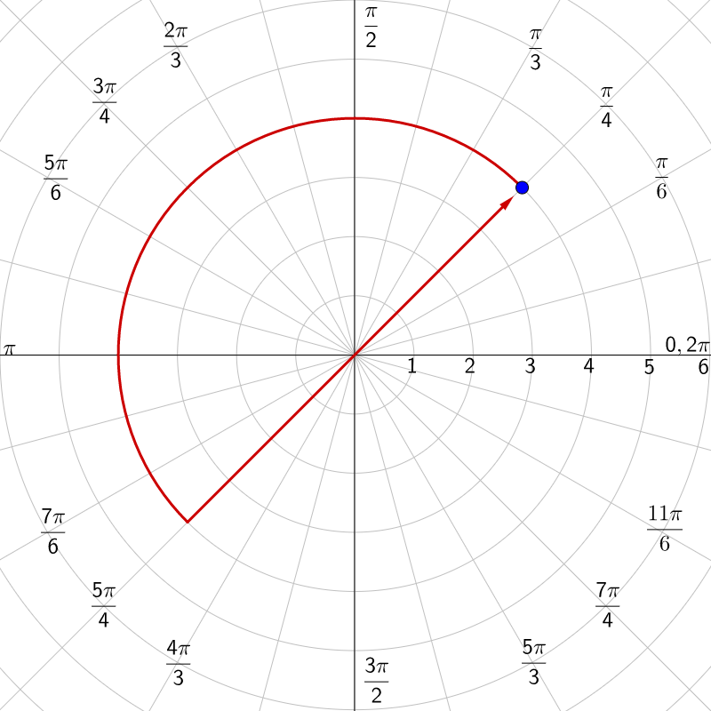
7-07 Polar Coordinates
Multiple ways to represent same point
$\left(r,θ\right)=\left(r,θ±2πn\right)$
Add full circles
$\left(r,θ\right)=\left(−r,θ±\left(2n+1\right)π\right)$
Opposite side of circle and add ½ circle

Slide 65
7-07 Polar Coordinates
Find 2 other ways to write $\left(3,\frac{π}{4}\right)$.
Notes:
Add a circle
$$\left(3,\frac{π}{4}+2π\right)$$
$$\left(3,\frac{9π}{4}\right)$$
Move to opposite side and add ½ circle
$$\left(−3,\frac{π}{4}+π\right)$$
$$\left(−3,\frac{5π}{4}\right)$$

Slide 66
7-07 Polar Coordinates
Convert between polar and rectangular
Polar → Rectangular
$x=r\cos{θ}$
$y=r\sin{θ}$
Rectangular → Polar
$r=\sqrt{x^{2}+y^{2}}$
$\tan{θ}=\frac{y}{x}$

Slide 67
7-07 Polar Coordinates
Convert $\left(4,\frac{π}{6}\right)$ to rectangular
Convert $\left(−1, 0\right)$ to polar
Notes:
$$x=r\cos{θ}$$
$$x=4\cos{\frac{π}{6}}$$
$$x=4\left(\frac{\sqrt{3}}{2}\right)=2\sqrt{3}$$
$$y=r\sin{θ}$$
$$y=4\sin{\frac{π}{6}}$$
$$y=4\left(\frac{1}{2}\right)=2$$
$$\left(2\sqrt{3}, 2\right)$$
$$r=\sqrt{x^{2}+y^{2}}$$
$$r=\sqrt{{\left(−1\right)}^{2}+{\left(0\right)}^{2}}$$
$$r=1$$
$$\tan{θ}=\frac{y}{x}$$
$$\tan{θ}=\frac{0}{−1}$$
$$θ=π$$
$$\left(1, π\right)$$

Slide 68
7-07 Polar Coordinates
Convert Equations
Convert $r=1$
Convert $θ=\frac{π}{4}$
Notes:
Substitute $r=\sqrt{x^{2}+y^{2}}$
$$\sqrt{x^{2}+y^{2}}=1$$
$$x^{2}+y^{2}=1$$
Circle with $r=1$
Use $\tan{θ}=\frac{y}{x}$
$$\tan{θ}=\tan{\frac{π}{4}}$$
$$\frac{y}{x}=1$$
$$y=x$$
Line

Slide 69
7-07 Polar Coordinates
Convert $r=\csc{θ}$
Notes:
Rewrite $r=\frac{1}{\sin{θ}}$
$$r\sin{θ}=1$$
Use $y=r\sin{θ}$
$$y=1$$
Horizontal line

Slide 70
7-08 Graphs of Polar Equations
In this section, you will:
Graph polar equations
Identify symmetry in polar equations
Find maximums and zeros of polar equations

Slide 71
7-08 Graphs of Polar Equations
To graph polar equations using a table
Pick $θ$ and calculate r
Graph $r=3\cos{θ}$
$$r$$ | 3 | 2.9 | 2.6 | 2.1 | 1.5 | 0.8 | 0
$$θ$$ | $$0$$ | $$π/12$$ | $$π/6$$ | $$π/4$$ | $$π/3$$ | $$5π/12$$ | $$π/2$$
$$r$$ | -0.8 | -1.5 | -2.1 | -2.6 | -2.9 | -3
$$θ$$ | $$7π/12$$ | $$2π/3$$ | $$3π/4$$ | $$5π/6$$ | $$11π/12$$ | $$π$$

Slide 72
7-08 Graphs of Polar Equations
Symmetry Tests (make the replacement and to simplify to original equation)
Line $θ=\frac{π}{2}$
Replace $\left(r,θ\right)$ with $\left(r,π−θ\right)$ or $\left(−r, −θ\right)$
Polar Axis
Replace $\left(r, θ\right)$ with $\left(r, −θ\right)$ or $\left(−r, π−θ\right)$
Pole
Replace $\left(r, θ\right)$ with $\left(r,π+θ\right)$ or $\left(−r, θ\right)$
Quick tests
If it is a function of $\cos{θ}$, then polar axis symmetry
If it is a function of $\sin{θ}$, then line $θ=\frac{π}{2}$ symmetry

Slide 73
7-08 Graphs of Polar Equations
Find the symmetry of $θ=\frac{π}{4}$
Line $θ=\frac{π}{2}$:
Replace $\left(r, θ\right)$ with $\left(−r, −θ\right)$
Polar axis
Replace $\left(r, θ\right)$ with $\left(r, −θ\right)$
Pole
Replace $\left(r, θ\right)$ with $\left(−r, θ\right)$
Notes:
$$−θ=\frac{π}{4}$$
$$θ=−\frac{π}{4}$$
This is different-no $θ=\frac{π}{2}$ symmetry
$$−θ=\frac{π}{4}$$
$$θ=−\frac{π}{4}$$
No for polar axis symmetry
$$θ=\frac{π}{4}$$
Same, YES for pole symmetry

Slide 74
7-08 Graphs of Polar Equations
Find the symmetry of $r=2\left(1−\sin{θ}\right)$
Notes:
This is a function of $\sin{θ}$, so quick test says
Line $θ=\frac{π}{2}$ symmetry

Slide 75
7-08 Graphs of Polar Equations
Maximums and Zeros of Polar Equations
Maximums occurs when |r| is largest.
Find angles where the trigonometric function is at its maximum.
Zeros occur when r = 0.
Find angles where the trigonometric function is 0.

Slide 76
7-08 Graphs of Polar Equations
Find the zeros and maximum r values of $r=5\cos{2θ}$
Notes:
Zeros
$$0=5\cos{2θ}$$
$$0=\cos{2θ}$$
$$2θ=\frac{π}{2}+nπ$$
$$θ=\frac{π}{4}+\frac{nπ}{2}$$
$$θ=\frac{π}{4},\frac{3π}{4},\frac{5π}{4},\frac{7π}{4}$$
Maximums
Cos is x on unit circle, so max is when $2θ=0+nπ$
$$θ=0+\frac{nπ}{2}$$
$$θ=0,\frac{π}{2},π,\frac{3π}{2}$$

Slide 77
7-09 Polar Graphs of Conics
In this section, you will:
Identify the type of a conic from its polar equation
Find the polar equation of a conic

Slide 78
7-09 Polar Graphs of Conics
Alternative Definition of a Conic Section
Locus of a point in the plane that moves so its distance from a fixed point (focus) is in a constant ratio to its distance from a fixed line (directrix).
The ratio is the eccentricity (e).
$e<1$ ellipse
$e=1$ parabola
$e>1$ hyperbola

Slide 79
7-09 Polar Graphs of Conics
e < 1 Ellipse
e = 1 Parabola
e > 1 Hyperbola
p = distance from focus to directrix
One focus is (0, 0)
The conic bends around the focus and away from directrix

Slide 80
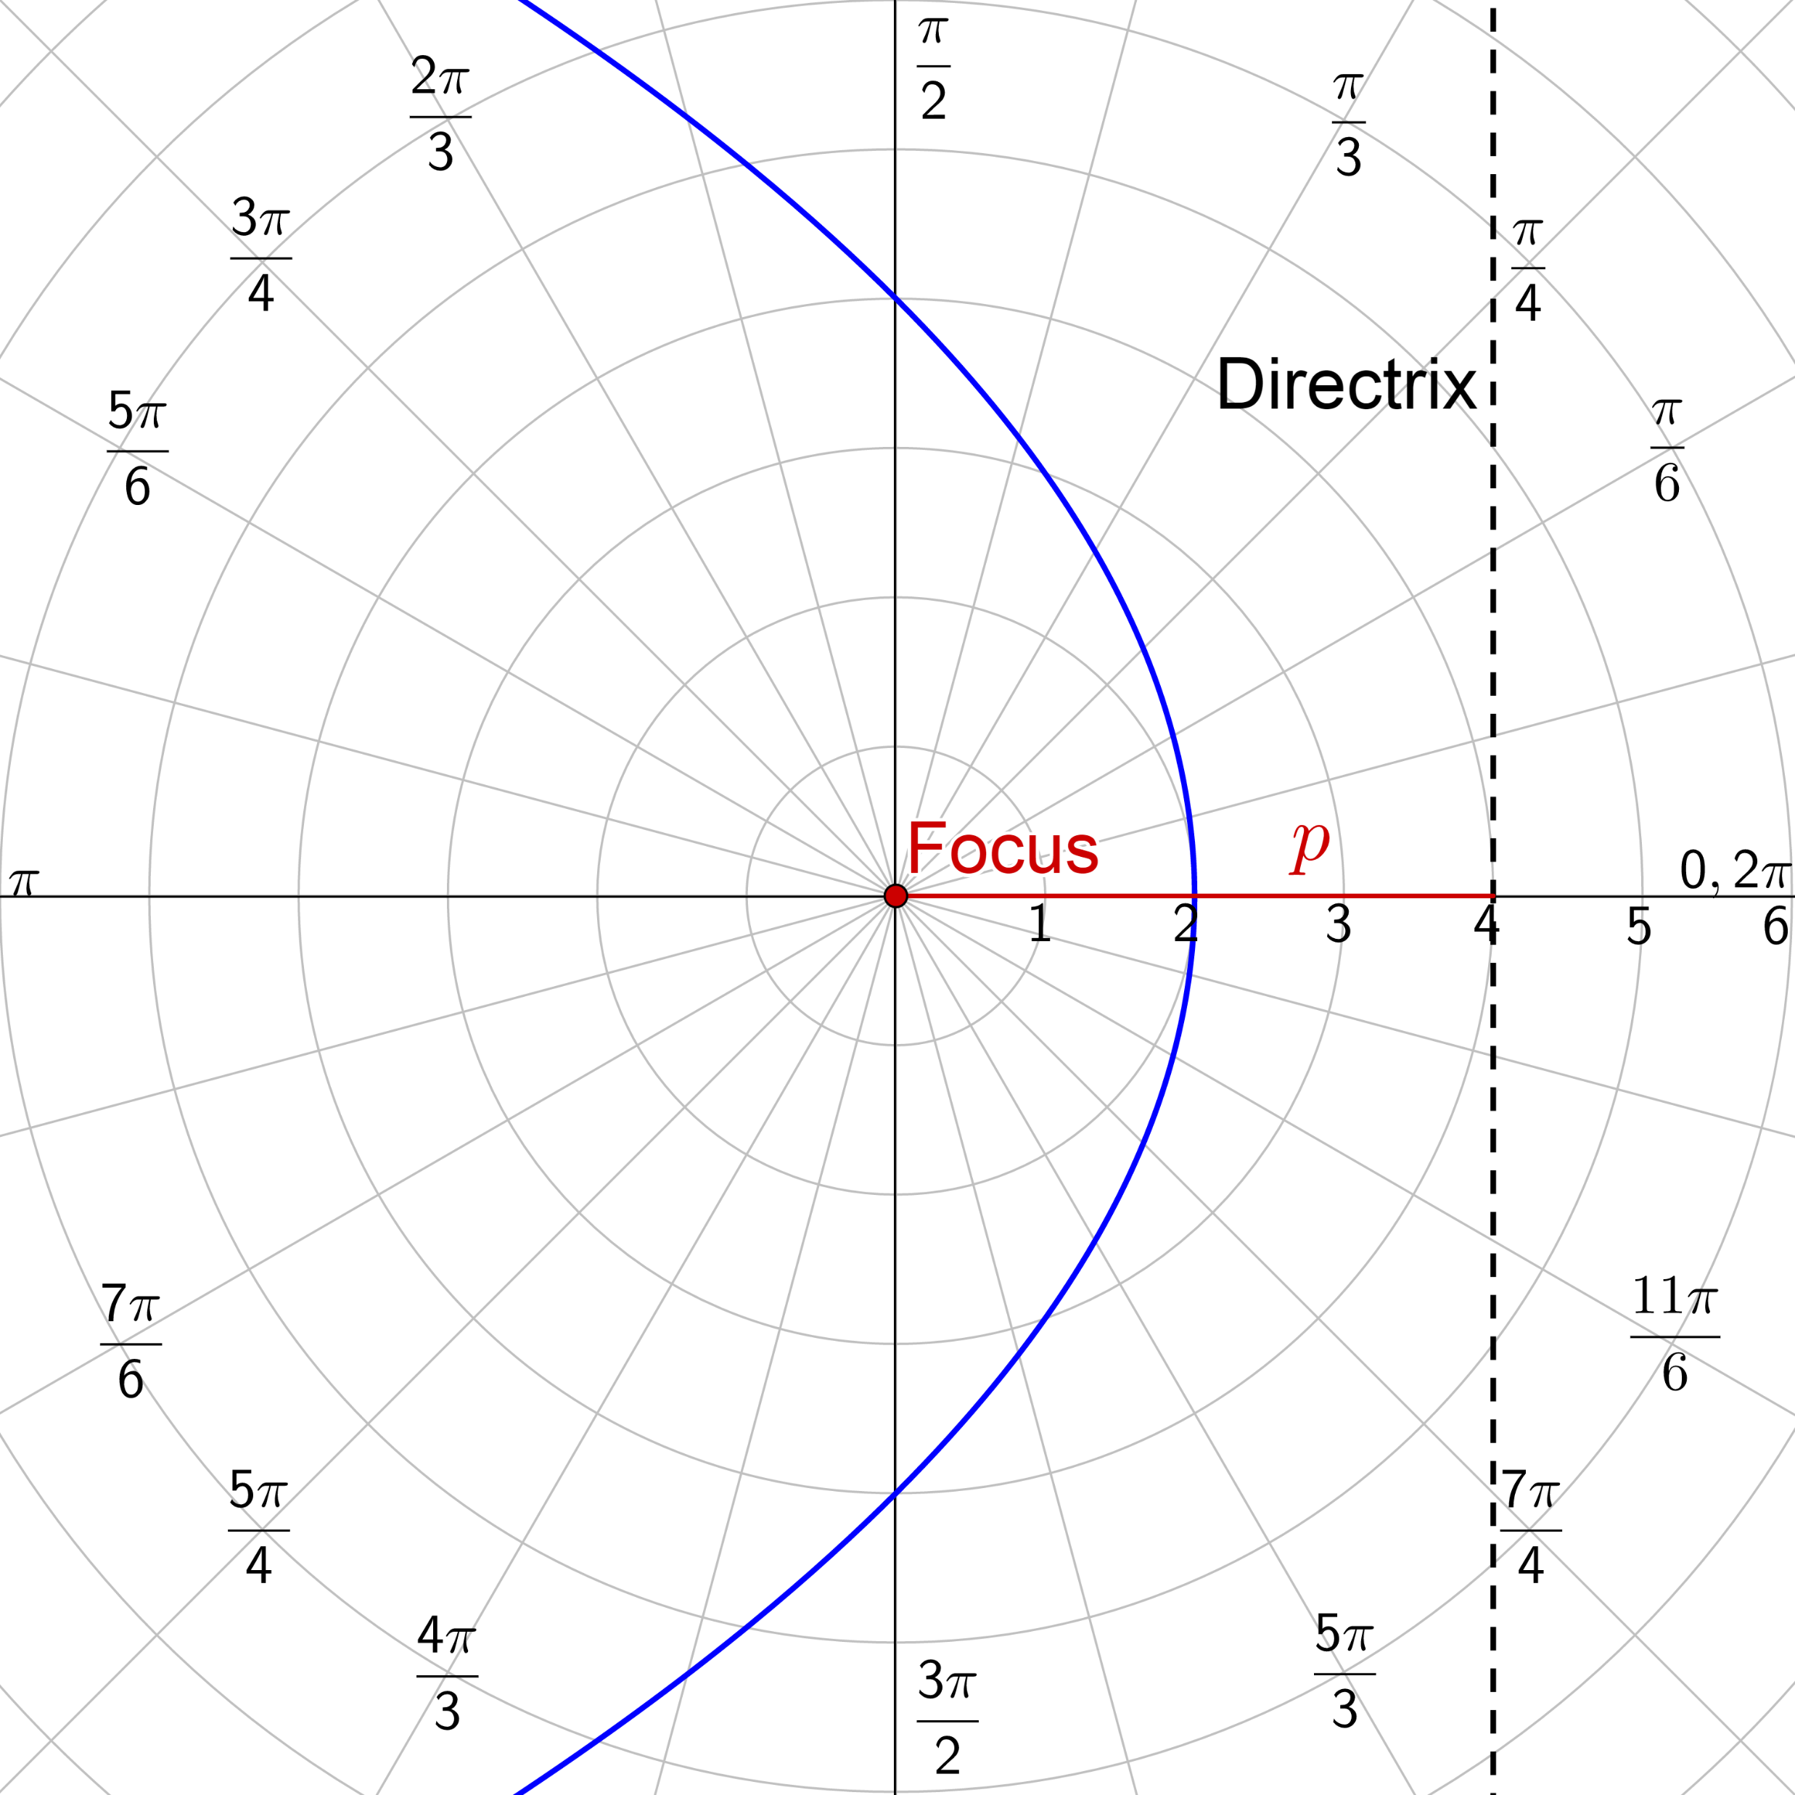
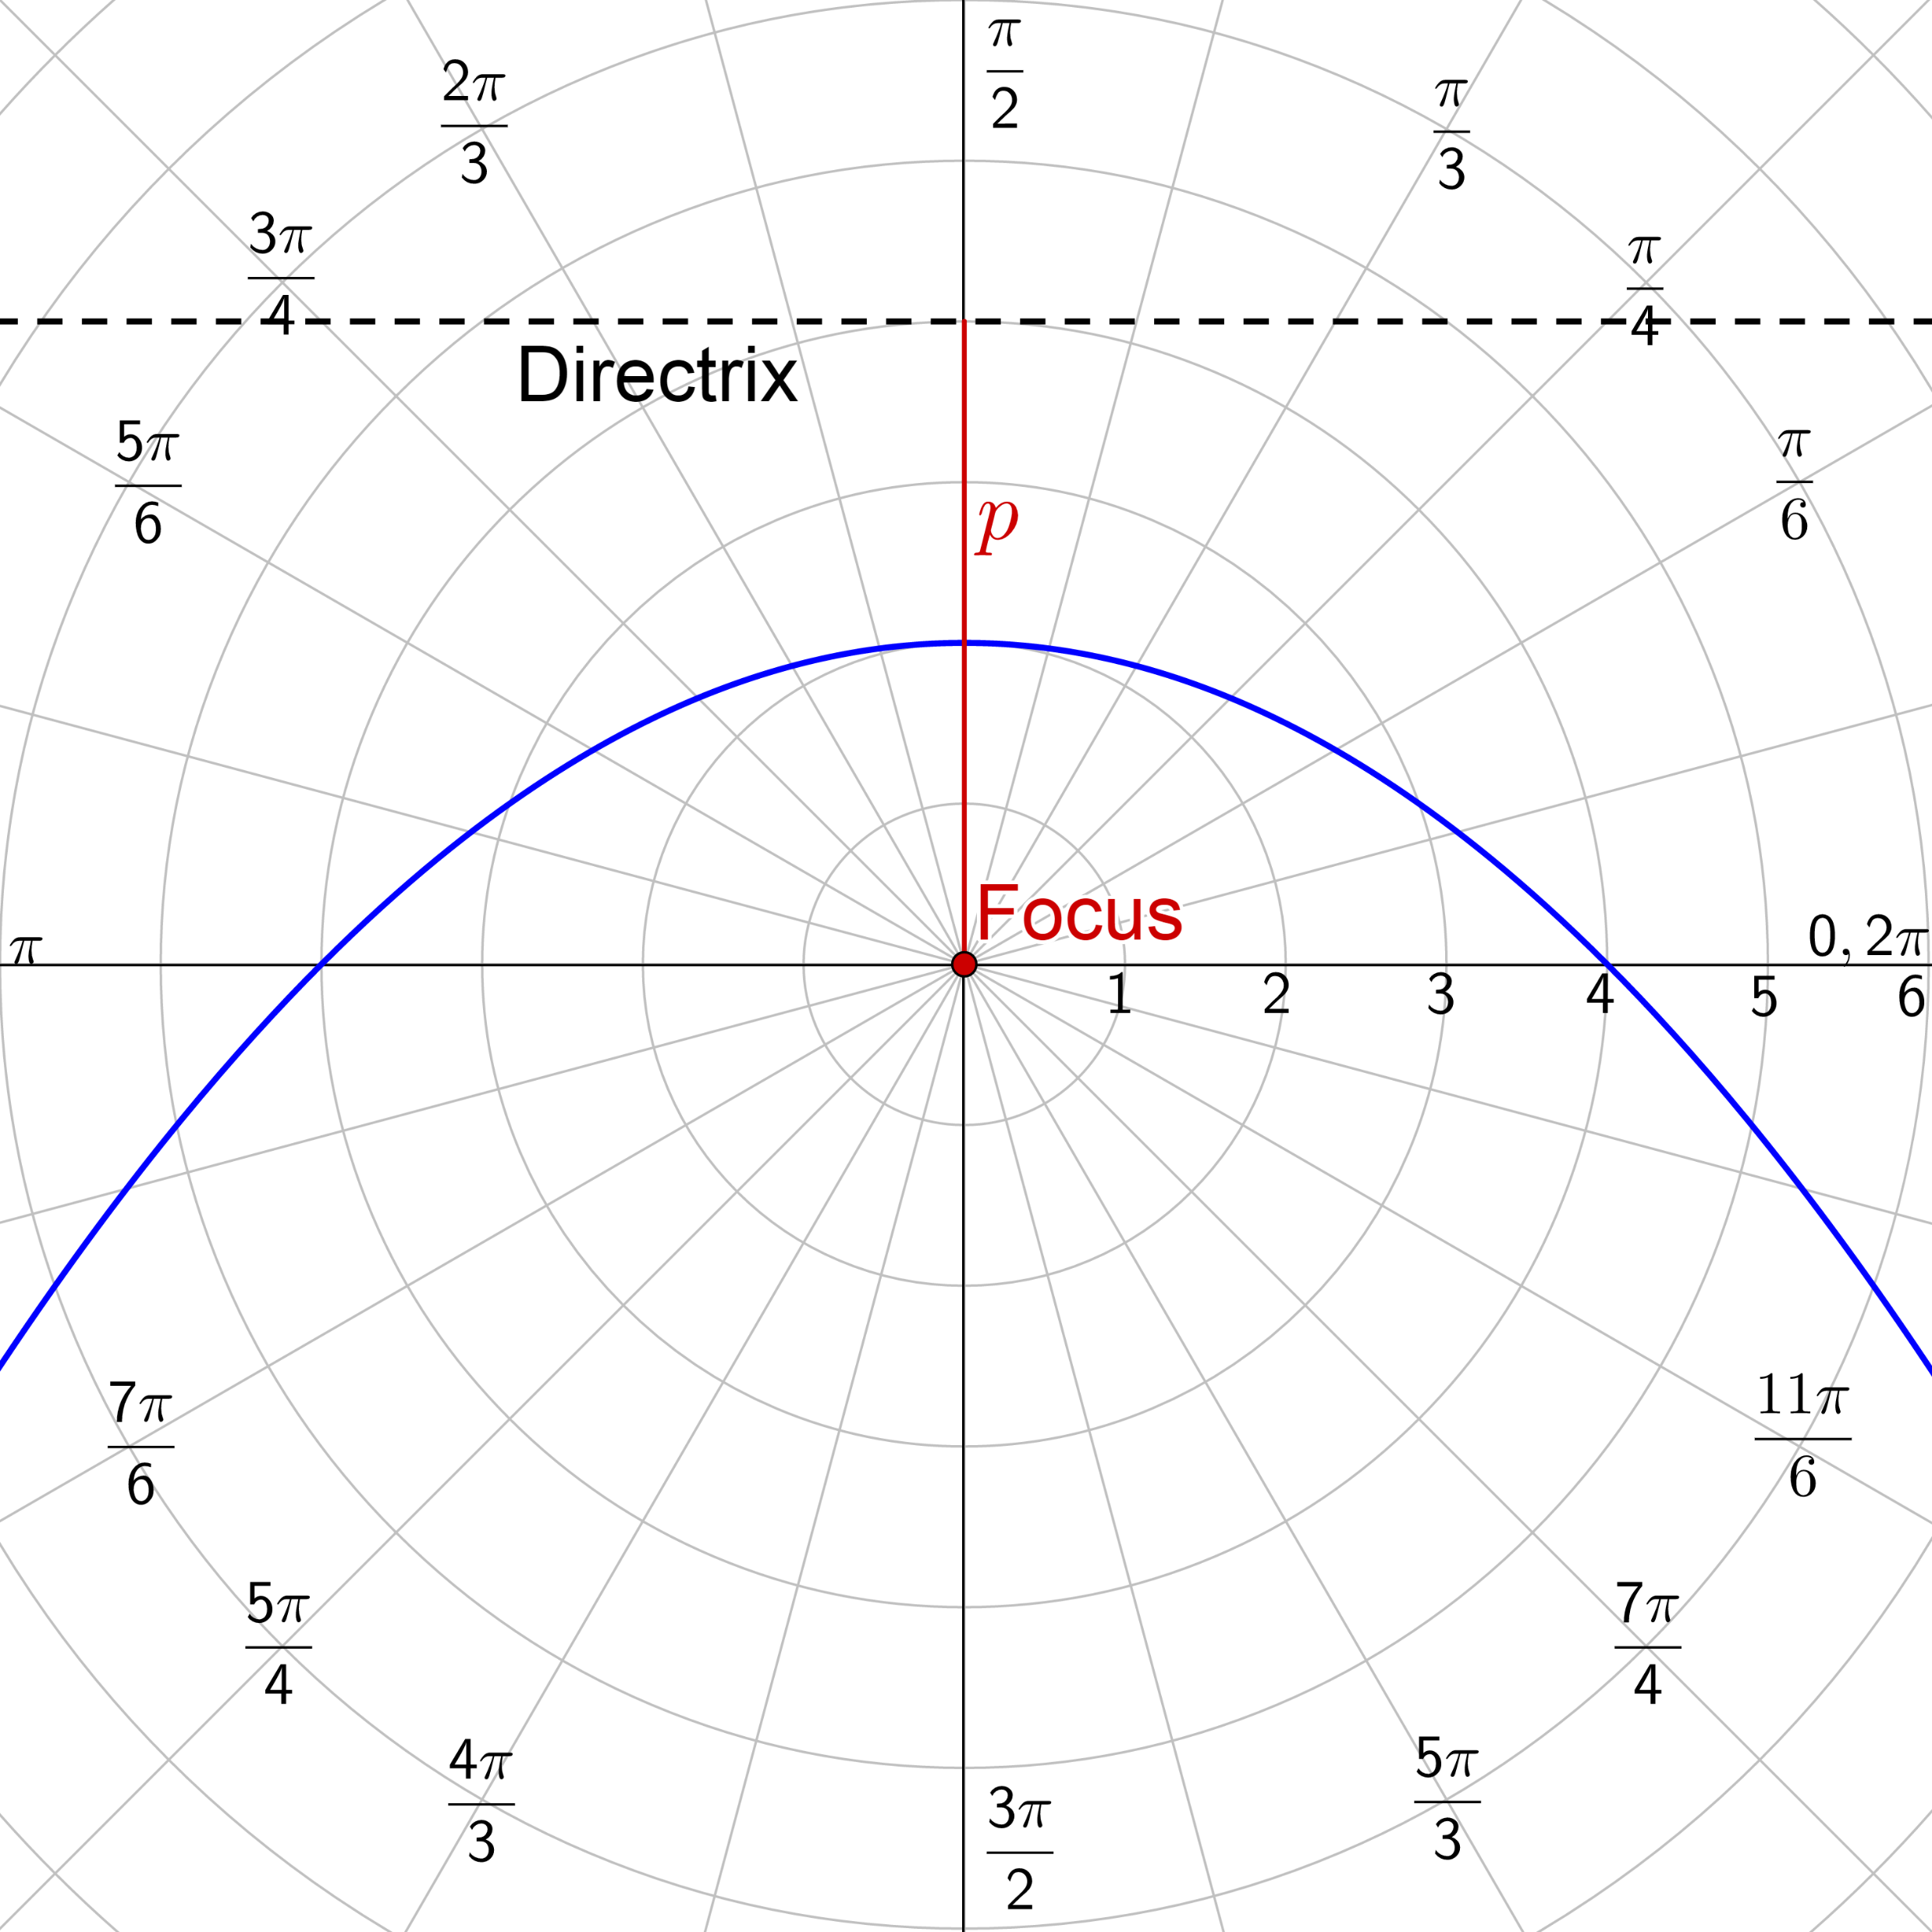
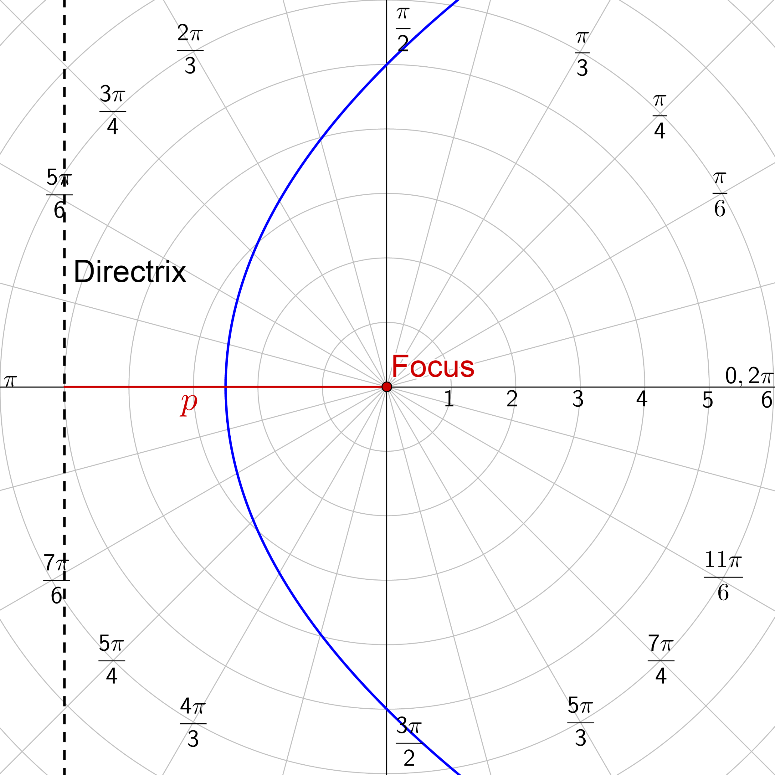
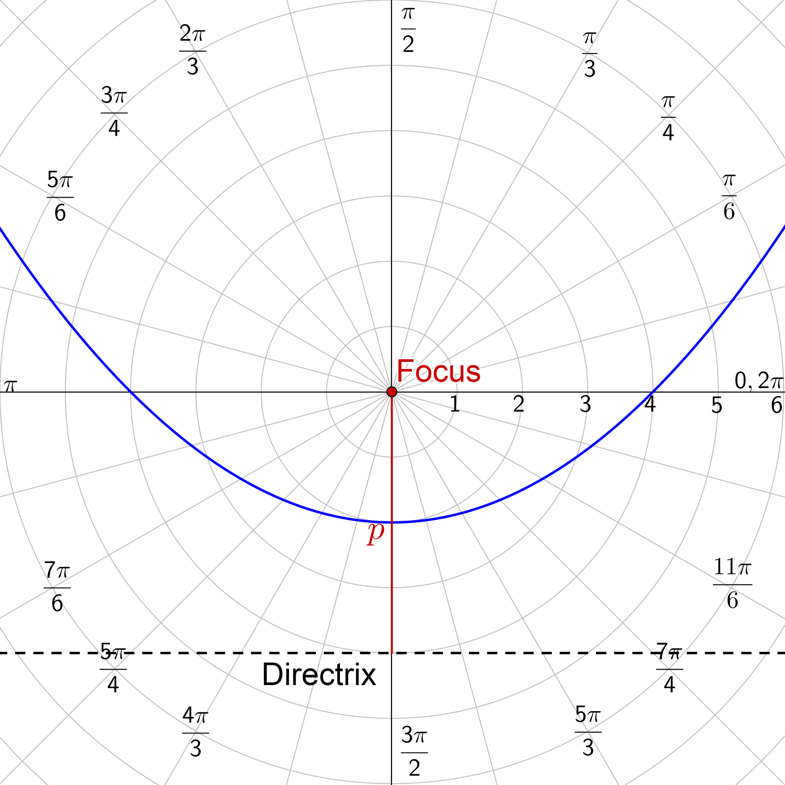
7-09 Polar Graphs of Conics
Vertical Directrix
Right of pole
$r=\frac{ep}{1+e\cos{θ}}$
Left of pole
$r=\frac{ep}{1−e\cos{θ}}$
Horizontal Directrix
Above pole
$r=\frac{ep}{1+e\sin{θ}}$
Below pole
$r=\frac{ep}{1−e\sin{θ}}$

Slide 81
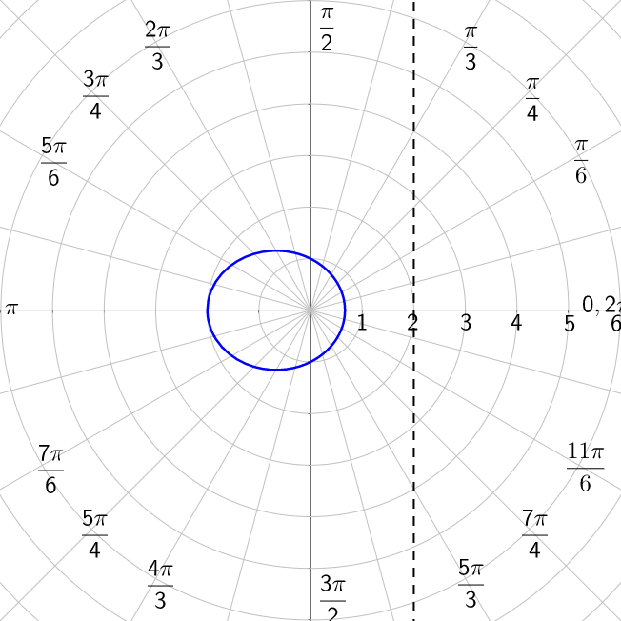
7-09 Polar Graphs of Conics
Identify the type of conic $r=\frac{2}{2+\cos{θ}}$
Notes:
Want it in the form $r=\frac{ep}{1+e\cos{θ}}$, so multiply top and bottom by ½ to get the 1
$$r=\frac{\frac{1}{2}\left(2\right)}{\frac{1}{2}\left(2+\cos{θ}\right)}$$
$$r=\frac{1}{1+\frac{1}{2}\cos{θ}}$$
This is vertical directrix to right of pole
$e=\frac{1}{2}<1$ so Ellipse

Slide 82
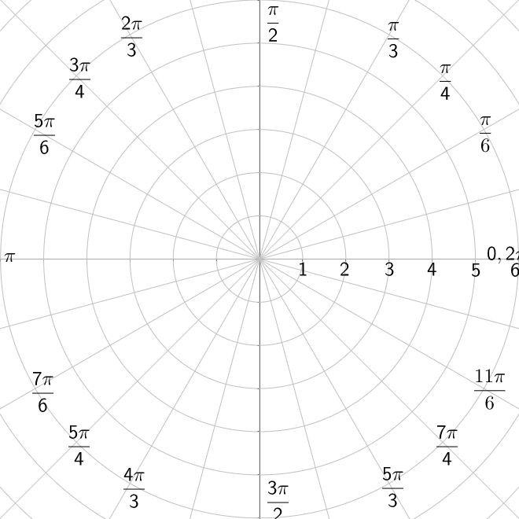
7-09 Polar Graphs of Conics
Identify type of conic and graph $r=\frac{3}{2−4\sin{θ}}$
Notes:
Want a 1 at beginning of denominator, so multiply top and bottom by ½
$$r=\frac{\frac{1}{2}\left(3\right)}{\frac{1}{2}\left(2−4\sin{θ}\right)}$$
$$r=\frac{\frac{3}{2}}{1−2\sin{θ}}$$
This is like $r=\frac{ep}{1−e\sin{θ}}$
Horizontal directrix below pole
$e=2>1$ Hyperbola
$$ep=\frac{3}{2}$$
$2p=\frac{3}{2}$ → $p=\frac{3}{4}$
Graph with a table

Slide 83
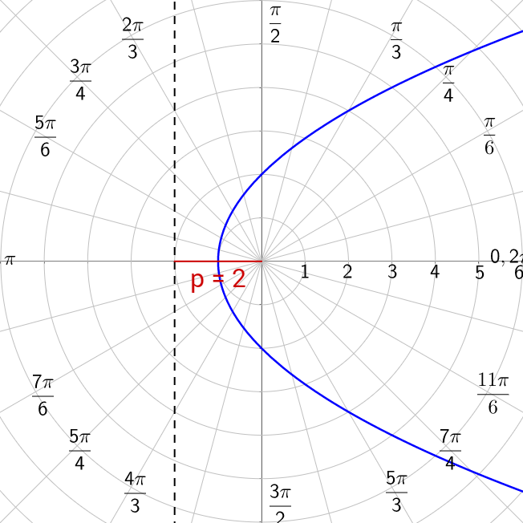
7-09 Polar Graphs of Conics
Find the polar equation of the parabola whose focus is the pole and directrix is the line $x=−2$.
Notes:
Graph the directrix and count to find p
p = 2
Parabola so e = 1
Vertical directrix to left of pole
$$r=\frac{ep}{1−e\cos{θ}}$$
$$r=\frac{2\left(1\right)}{1−\left(1\right)\cos{θ}}$$
$$r=\frac{2}{1−\cos{θ}}$$

Slide 84
7-09 Polar Graphs of Conics
Find the polar equation of the hyperbola with focus at pole and vertices $\left(1,\frac{3π}{2}\right)$ and $\left(−9,\frac{π}{2}\right)$.
Continued on next slide
Notes:
Graph the vertices.
The center is midpoint between vertices
a = center to vertex = 4
c = center to focus = 5
$$e=\frac{c}{a}=\frac{5}{4}$$
Horizontal directrix below pole
$$r=\frac{ep}{1−e\sin{θ}}$$
$$r=\frac{\frac{5}{4}p}{1−\frac{5}{4}\sin{θ}}$$
Multiply top and bottom by 4 to remove fractions
$$r=\frac{5p}{4−5\sin{θ}}$$

Slide 85
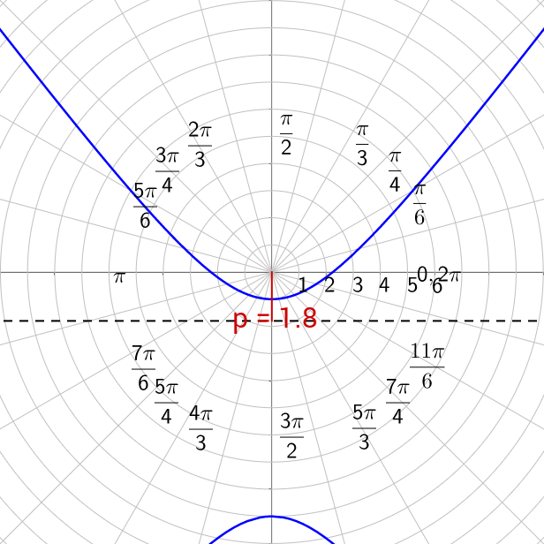
7-09 Polar Graphs of Conics
Plug in a point $\left(1,\frac{3π}{2}\right)$ to find p
Write final equation
Notes:
$$r=\frac{5p}{4−5\sin{θ}}$$
$$1=\frac{5p}{4−5\sin{\frac{3π}{2}}}$$
$$1=\frac{5p}{4−5\left(−1\right)}$$
$$1=\frac{5p}{9}$$
$$9=5p$$
$$r=\frac{5p}{4−5\sin{θ}}$$
$$r=\frac{9}{4−5\sin{θ}}$$

